Slide 1
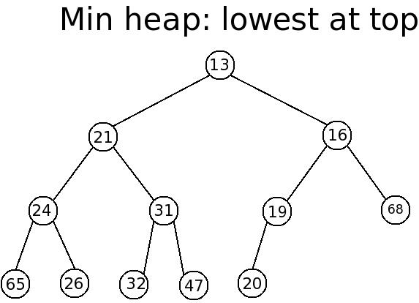
Lecture 18 Fall 2016: Heaps and Heapsort
Final exam: Fri 12/16 8:30-10:30 AM RB-250
Heaps, conceptually
Heap Sort
Priority queues
Using heaps to implement priority queues

Slide 2
Heaps
A heap is a complete binary tree in which each element is less than or equal to both of its children (different than BST property).
So a heap has both structural and ordering constraints.
This has implications for storing the HEAP as an array!

Slide 3
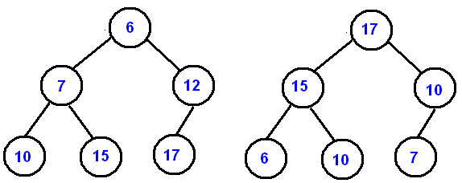
Heaps
As with binary search trees, there are many possible heap configurations for a given set of elements
Our definition above is really a minheap
A similar definition could be made for a maxheap
minheap
maxheap

Slide 4
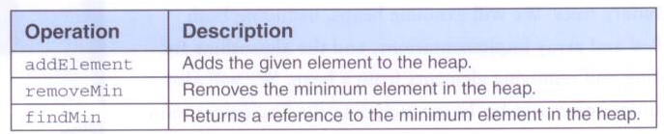
Heaps
Operations on a heap:

Slide 5
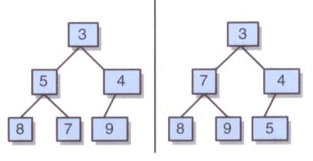
Heaps
Two minheaps containing the same data:

Slide 6
Adding a New Element
To add an element to the heap, add the element as a leaf, keeping the tree complete
Then, move the element up toward the root, exchanging positions with its parent, until the relationship among the elements is appropriate
This will guarantee that the resulting tree will conform to the heap criteria

Slide 7
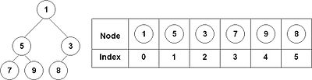
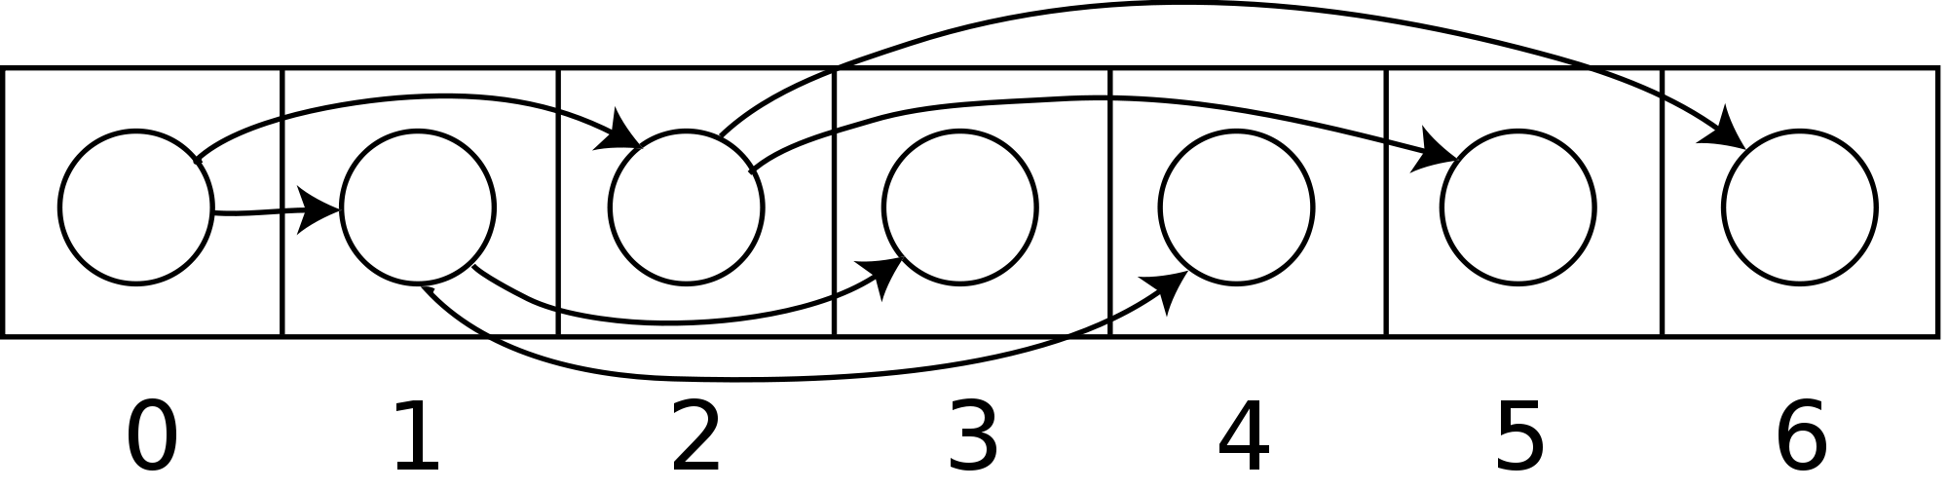
Relationship between array and heap
its LEFT child is located at (2*k)+1 index its RIGHT child is located at (2*k)+2 index its PARENT is located at (k-1)/2 index
If node at index 2 had a right child it would be at index 6.

Slide 8
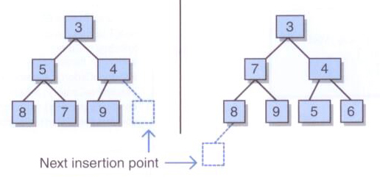
Adding a New Element
The initial insertion point for a new element in a heap:

Slide 9
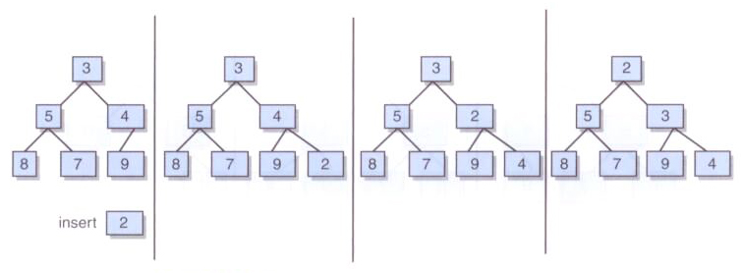
Adding a New Element
Inserting an element (at end of array) and moving it up (siftUp) the tree as far as appropriate:
http://www.algolist.net/Data_structures/Binary_heap/Insertion

Slide 10
INSERT into HEAP step 1
public class BinaryMinHeap {
…
public void insert(int value) {
if (heapSize == data.length)
throw new HeapException("Heap's underlying storage is overflow");
else {
heapSize++;
data[heapSize - 1] = value;
siftUp(heapSize - 1);
}
}
…

Slide 11
Insert into Heap: SIFTUP step 2
private void siftUp(int nodeIndex) {
int parentIndex, tmp;
if (nodeIndex != 0) { // not top node
parentIndex = getParentIndex(nodeIndex);
if (data[parentIndex] > data[nodeIndex]) {
tmp = data[parentIndex]; //swap
data[parentIndex] = data[nodeIndex];
data[nodeIndex] = tmp;
siftUp(parentIndex); // make another pass
}
}
}

Slide 12
Removing the Min Element
Remove the root (min) and reconstruct the heap
First, move the last leaf of the tree to be the new root of the tree
Then, move it down (siftDown) the tree as needed until the relationships among the elements is appropriate
In particular, compare the element to the smaller of its children and swap them if the child is smaller.

Slide 13
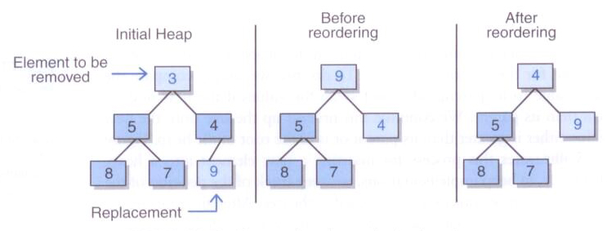
Removing the Min Element: compare & swap with smaller child, until we are at leaf node.

Slide 14
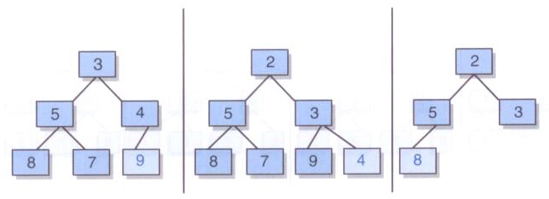
Removing the Min Element
The element to replace the root is the "last leaf" in the tree: (all of these are the “last leafs”)
Review: There are three different examples above. Remove the root from each of them, replace with last leaf, and siftDown. What do the remaining heaps look like?

Slide 15
Priority Queues
Recall that a FIFO queue removes elements in the order in which they were added
A priority queue removes elements in priority order, independent of the order in which they were added, the highest priority would be at the root.
Priority queues are helpful in many scheduling situations: boarding an aircraft, CPU scheduling, etc.
A heap is a classic mechanism for implementing priority queues

Slide 16
Heap Sort: O(n*log(n))
Given the ordering property of a heap, it is natural to think of using a heap to sort a list of numbers
A heap sort sorts a set of elements by adding each one to a heap, then removing them one at a time
The smallest element comes off the heap first, so the sequence will be in ascending order

Slide 17
Heapsort using a minheap
Insert each element in turn from ane unsorted array into a heap.
While there is data in the heap:
Use removeMin to extract the minimum value and place it into next position in a sorted array.
As you recall, removeMin take the smallest value and does a siftUp of the last leaf.

Slide 18
Heapsort using a maxheap
The maxheap heapsort algorithm involves preparing the list by first turning it into a max heap. The algorithm then repeatedly swaps the first (root) value of the list with the last leaf value, decreasing the range of values considered in the heap operation by one, and shifting the new first value into its position in the heap. This repeats until the range of considered values is one value in length.

